Slide 1
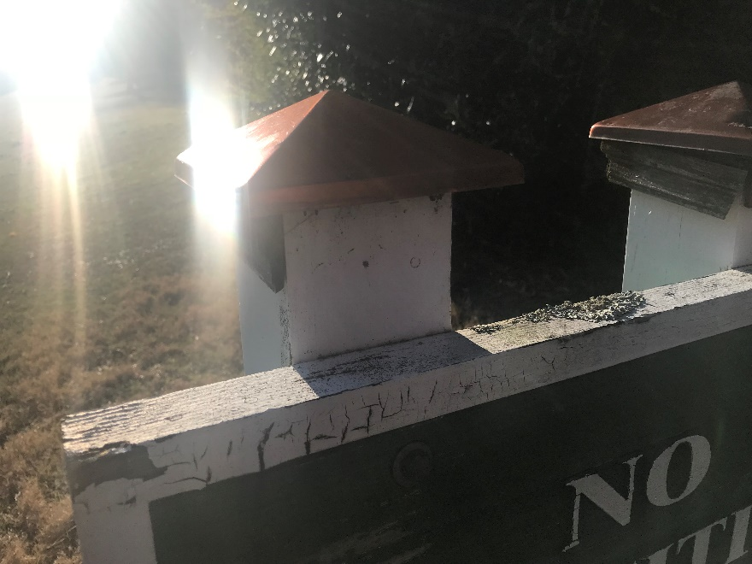
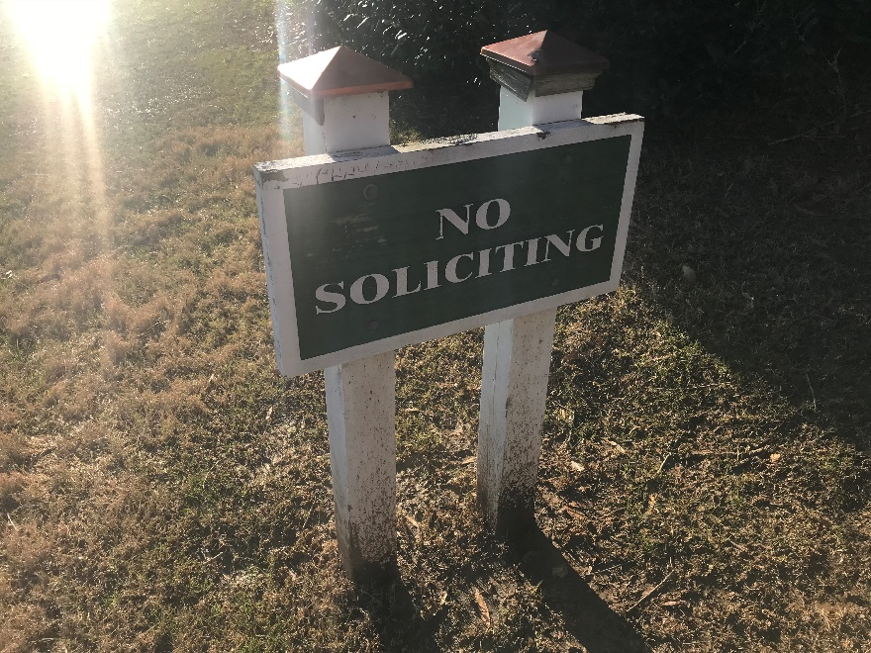
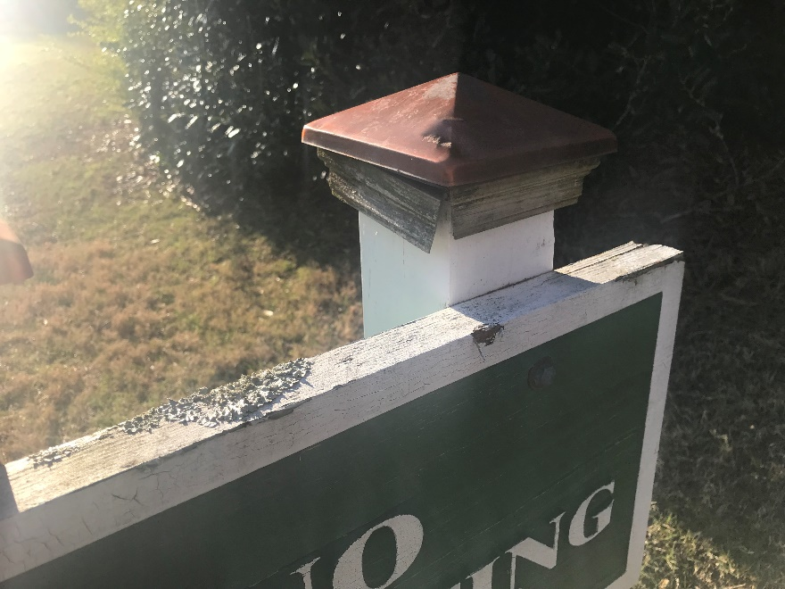
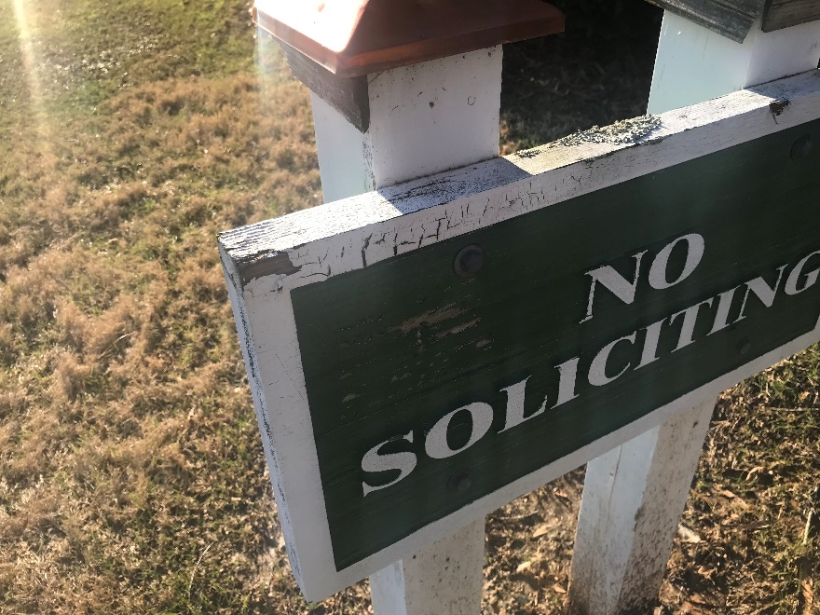
No Soliciting sign at front of Subdivision – Sign needs to be painted and trim fixed

Slide 2
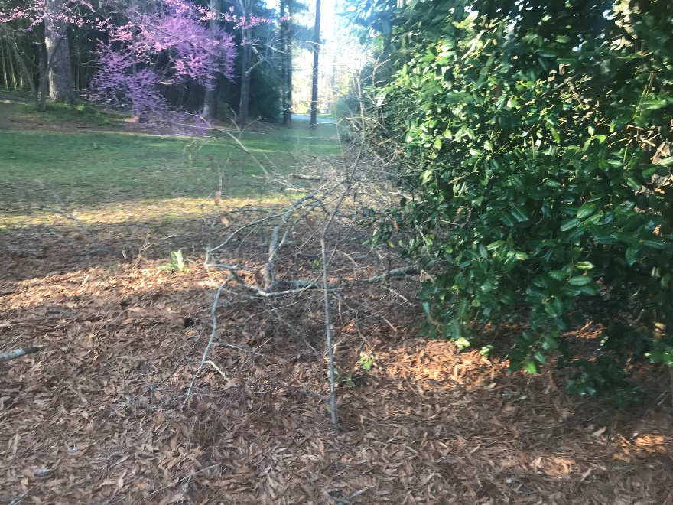
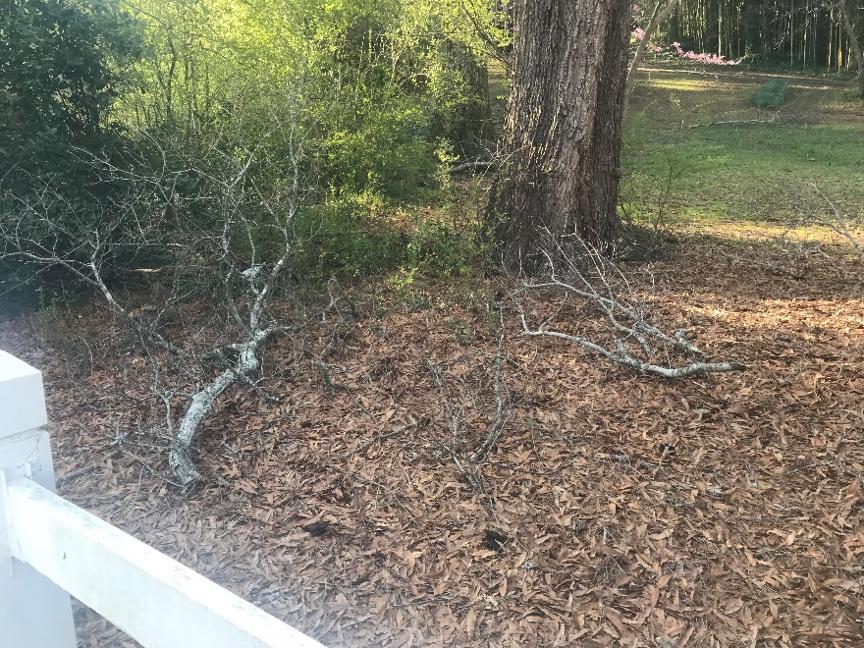
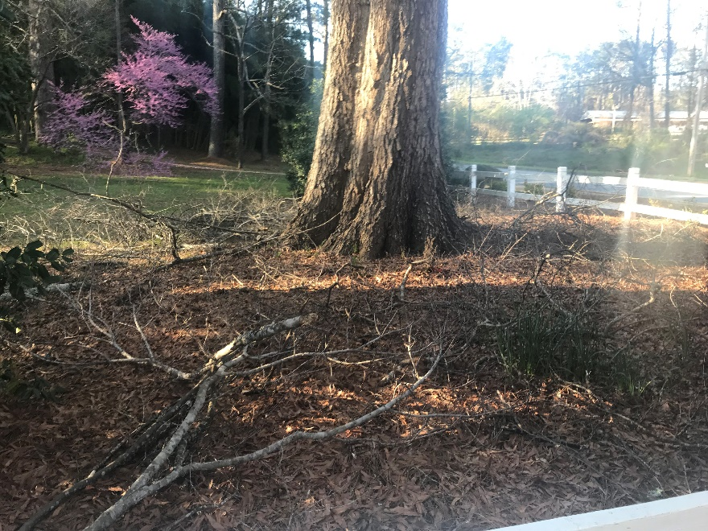
Area at front of Subdivision – Fallen Limbs need to be picked up, cut and disposed of

Slide 3
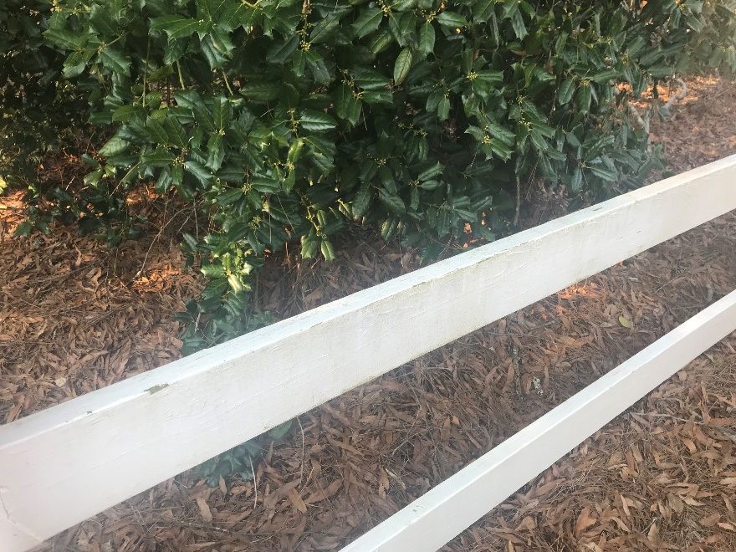
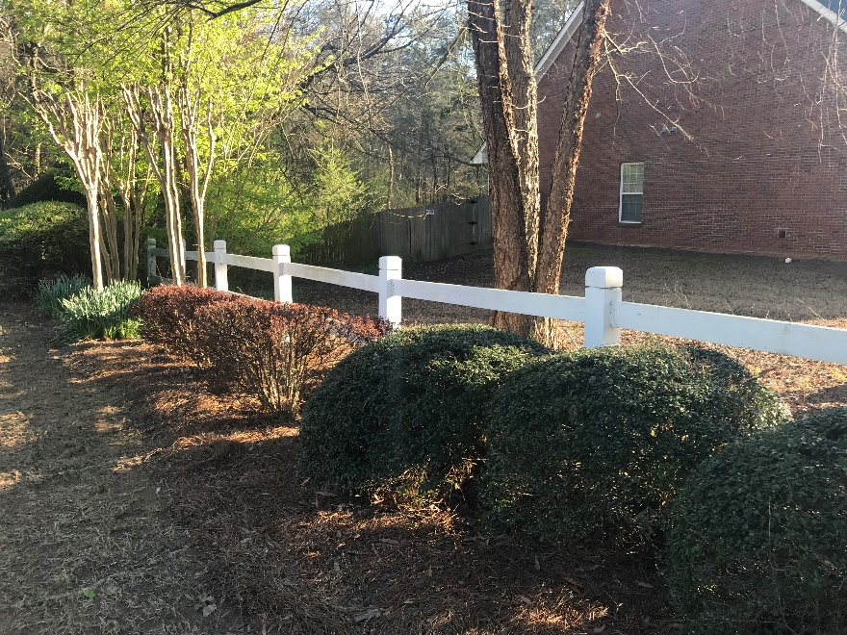
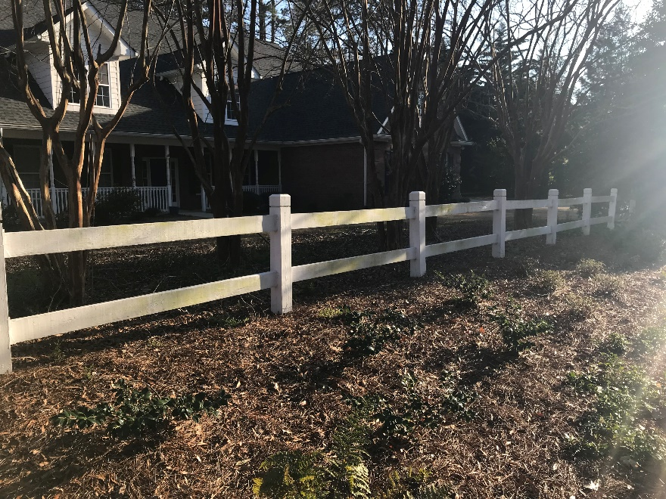
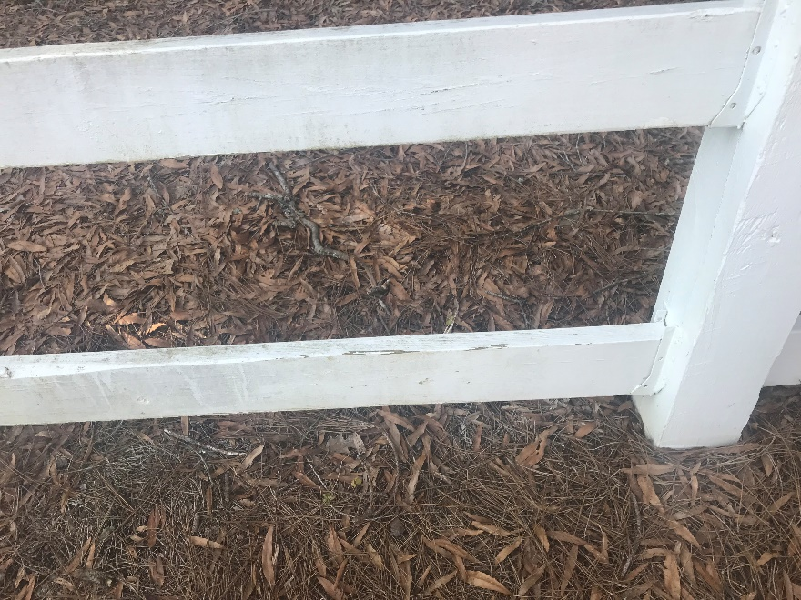
Fencing at Front – Needs to be powerwashed and painted

Slide 4
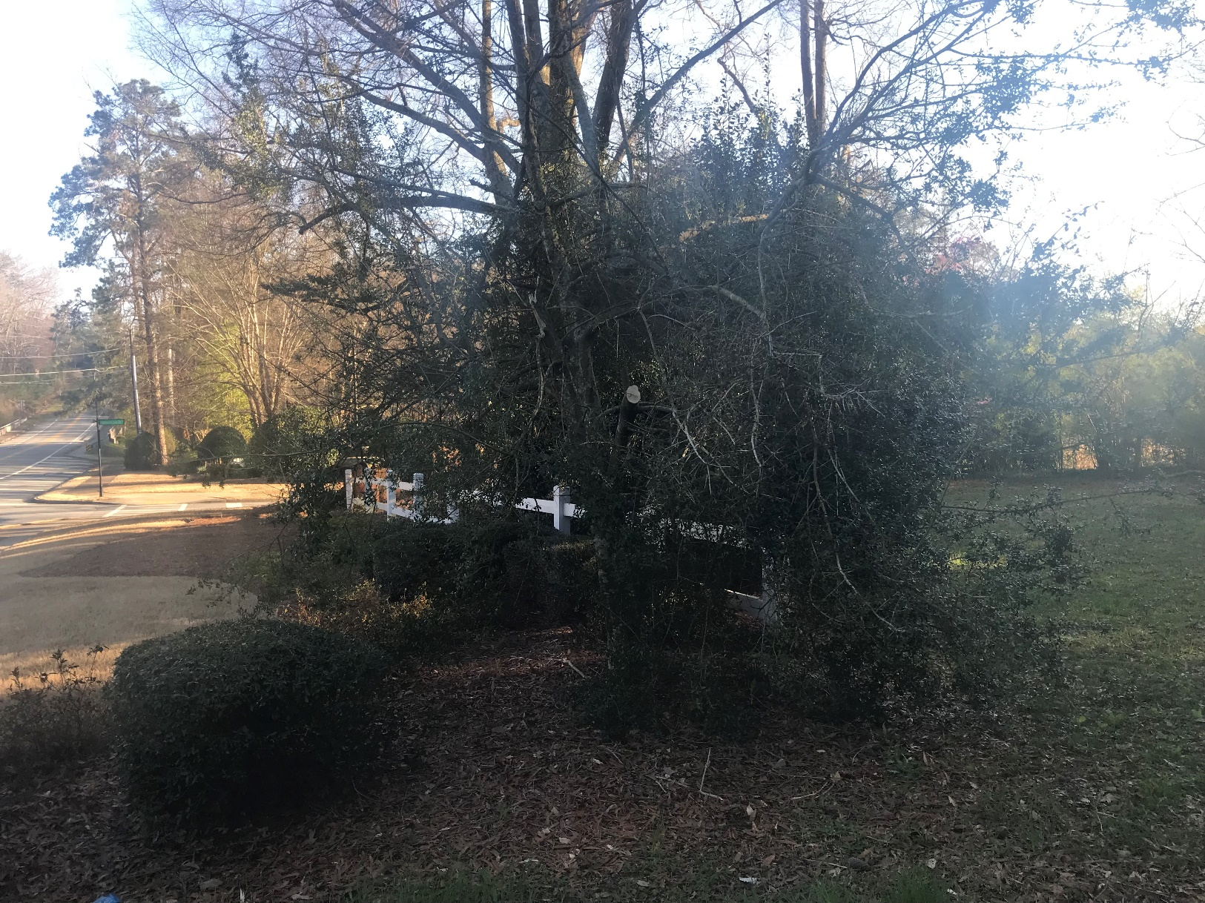
Tree at front – Broken during storms, needs to be trimmed, possibly removed and limbs discarded

Slide 5
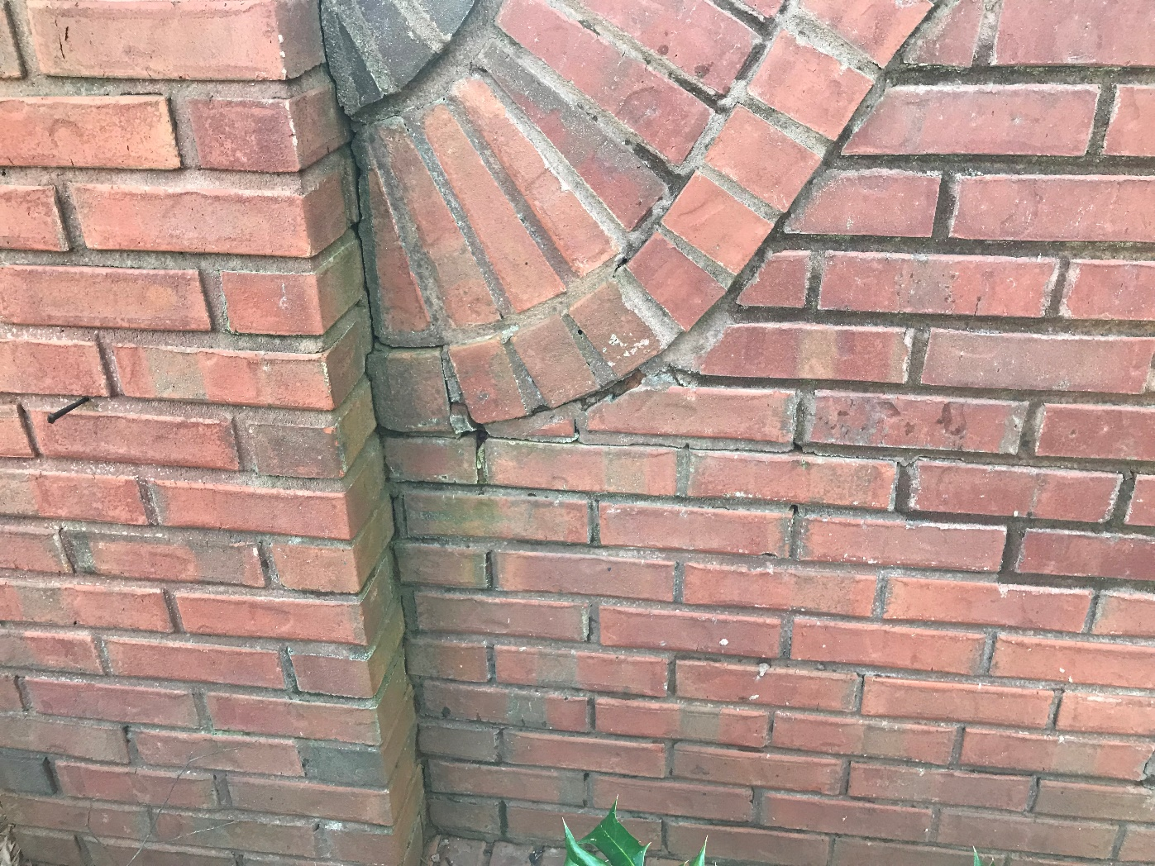
Entrance Subdivision Signs – Need to be powerwashed. Some areas may need to be re-grouted

Slide 6
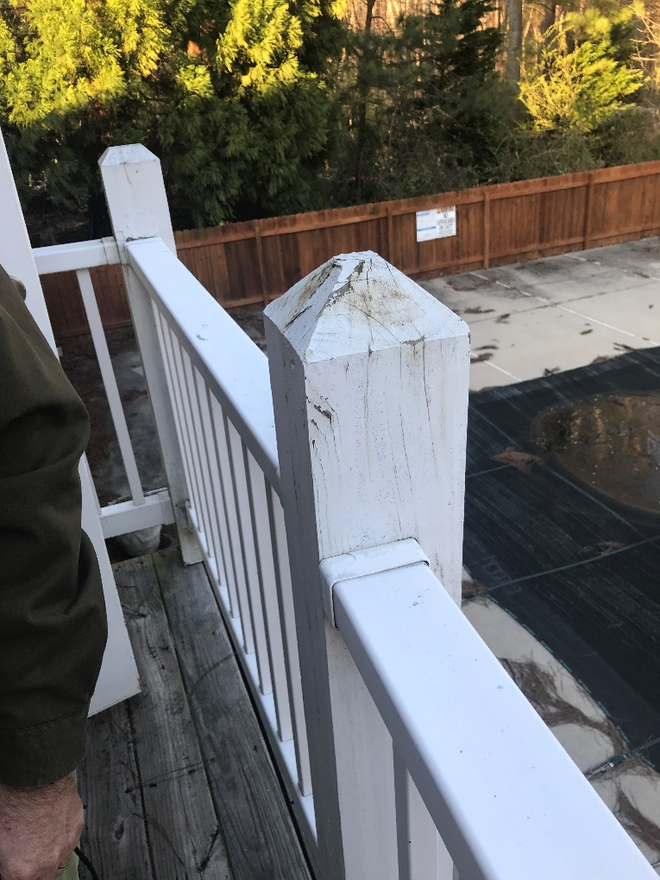
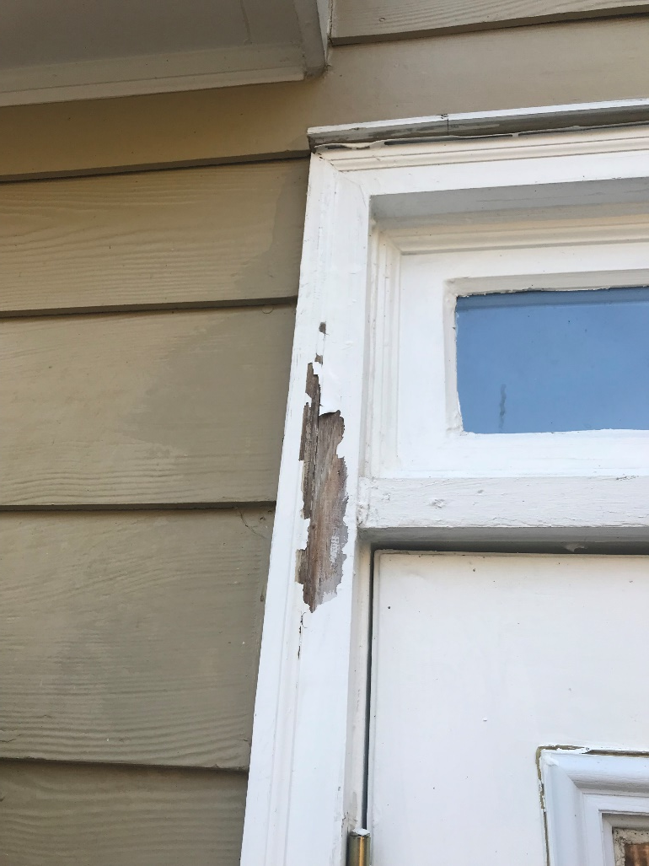
White trim around Club house – trim around doors and deck need to be painted and old chipped Paint removed.

Slide 7
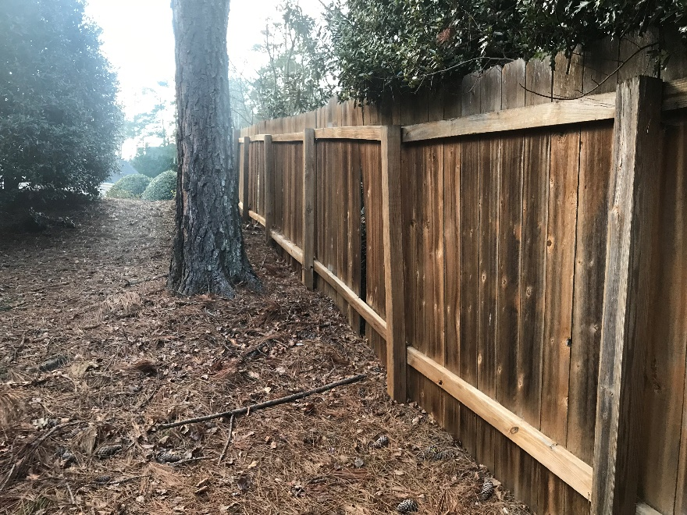
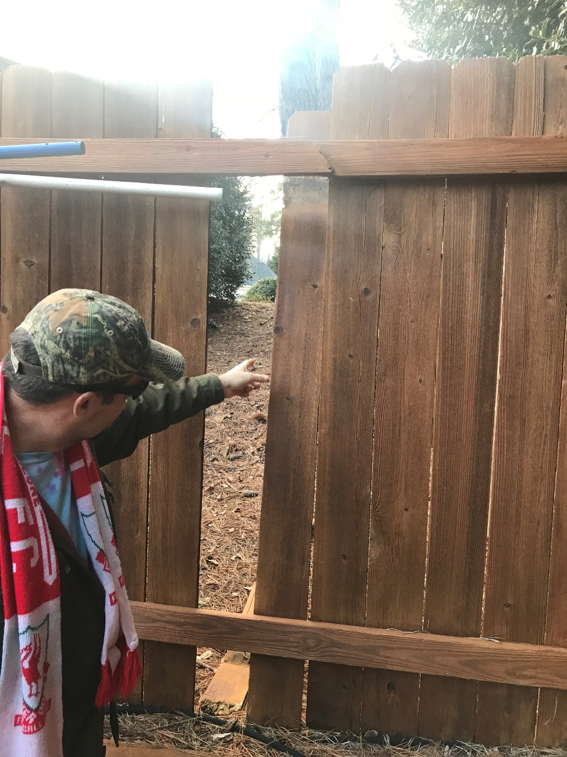
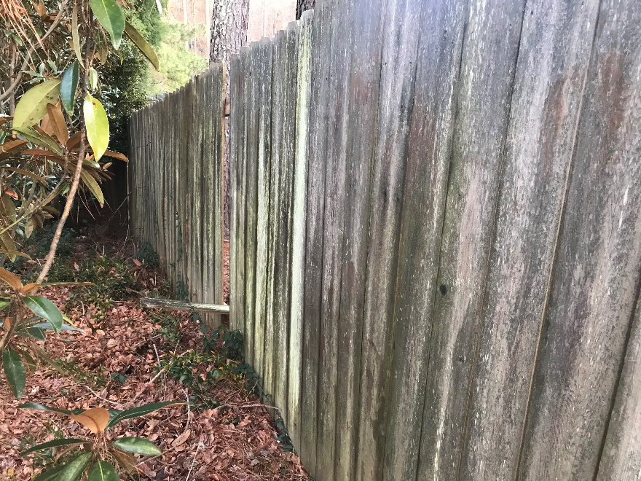
Fence at Clubhouse – Several slats need to be fixed / replaced. Some stringer boards need to be replaced.

Slide 8
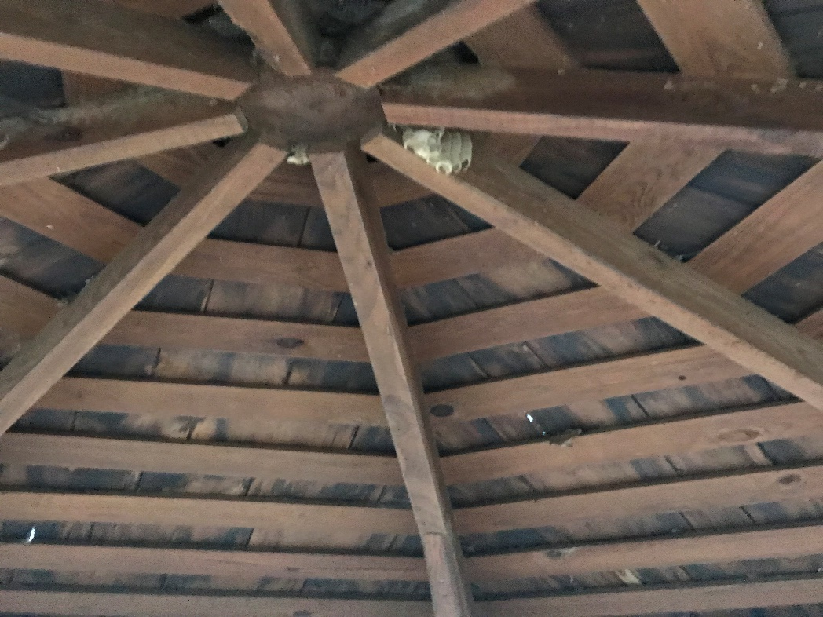
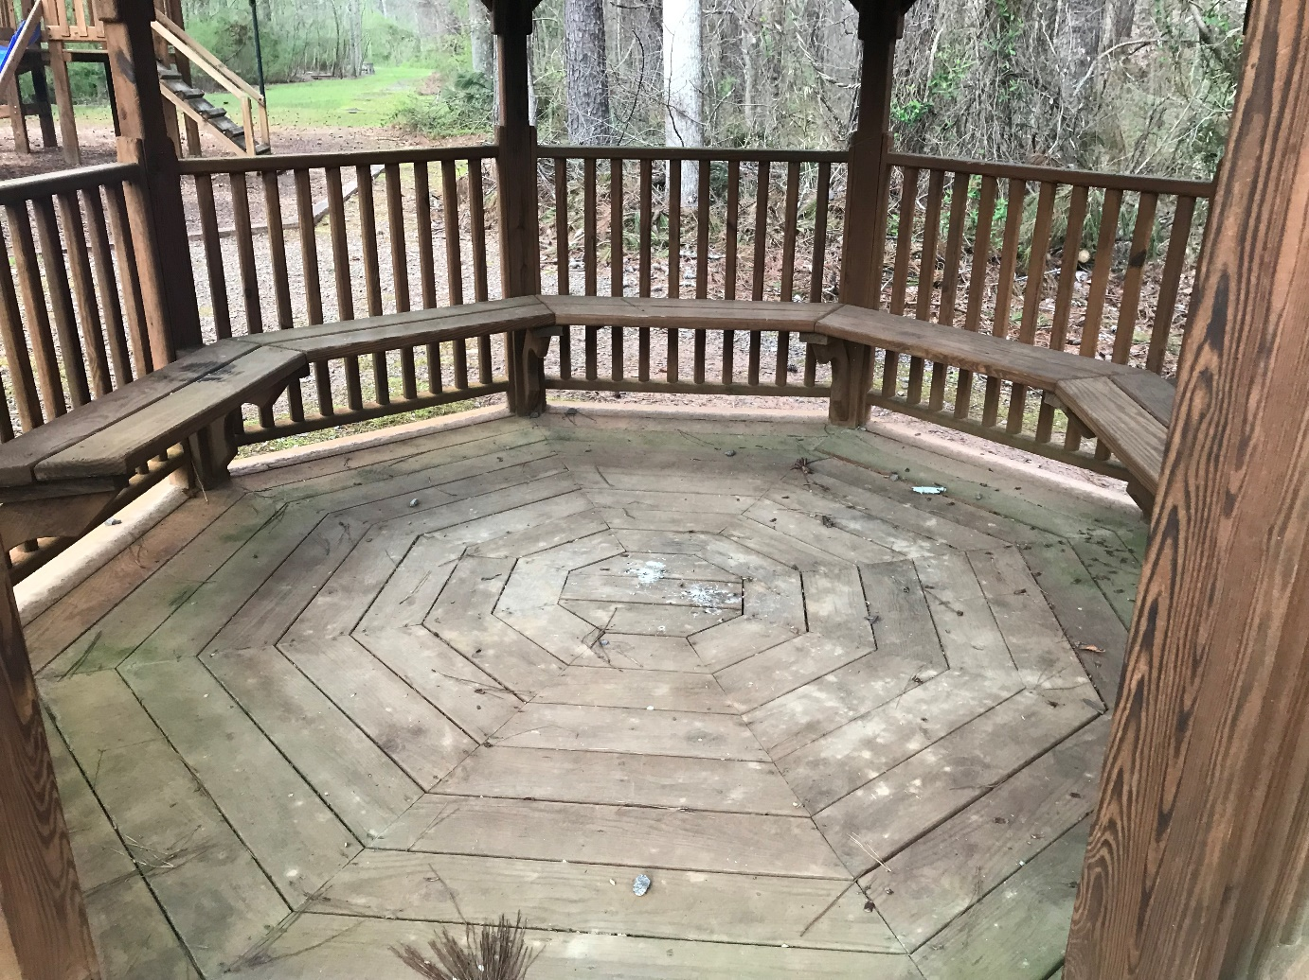
Gazebo Area – Needs to be powerwashed and treated

Slide 9
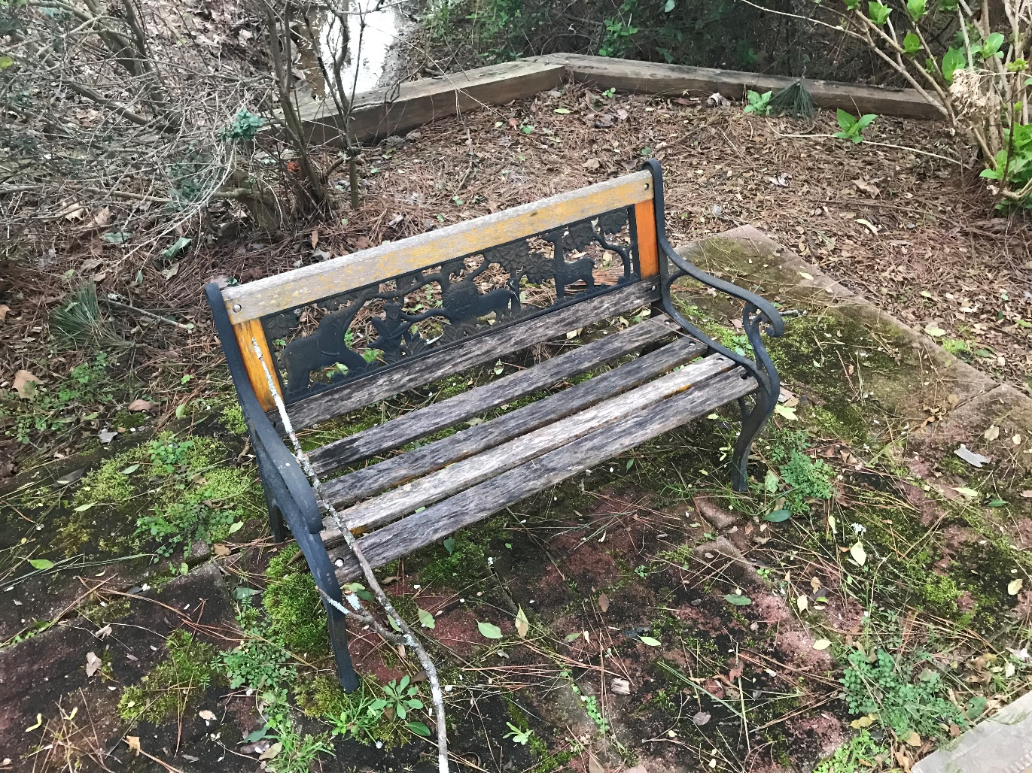
Childrens Memorial – Bench slats need to be fixed and area around bricks weeded and bricks powerwashed

Slide 10
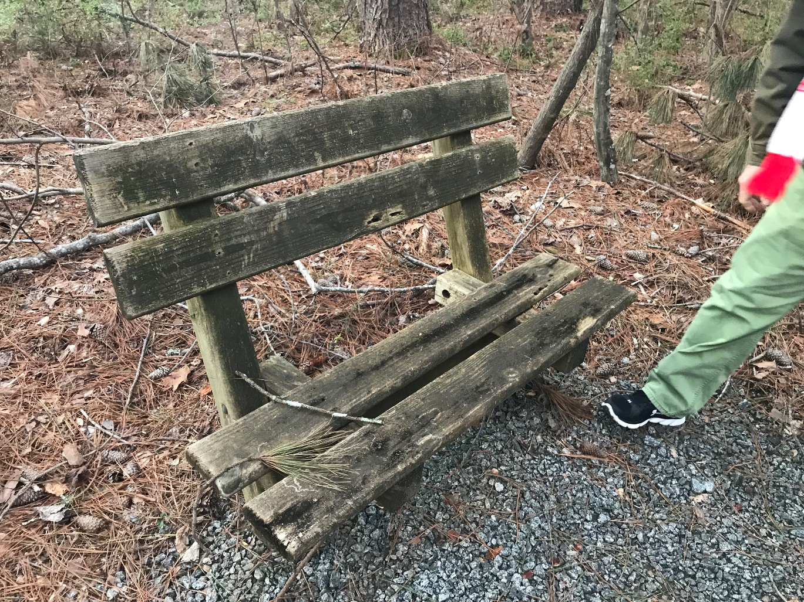
Bench along walk path – Old boards need to be replaced, powerwashed and treated

Slide 11
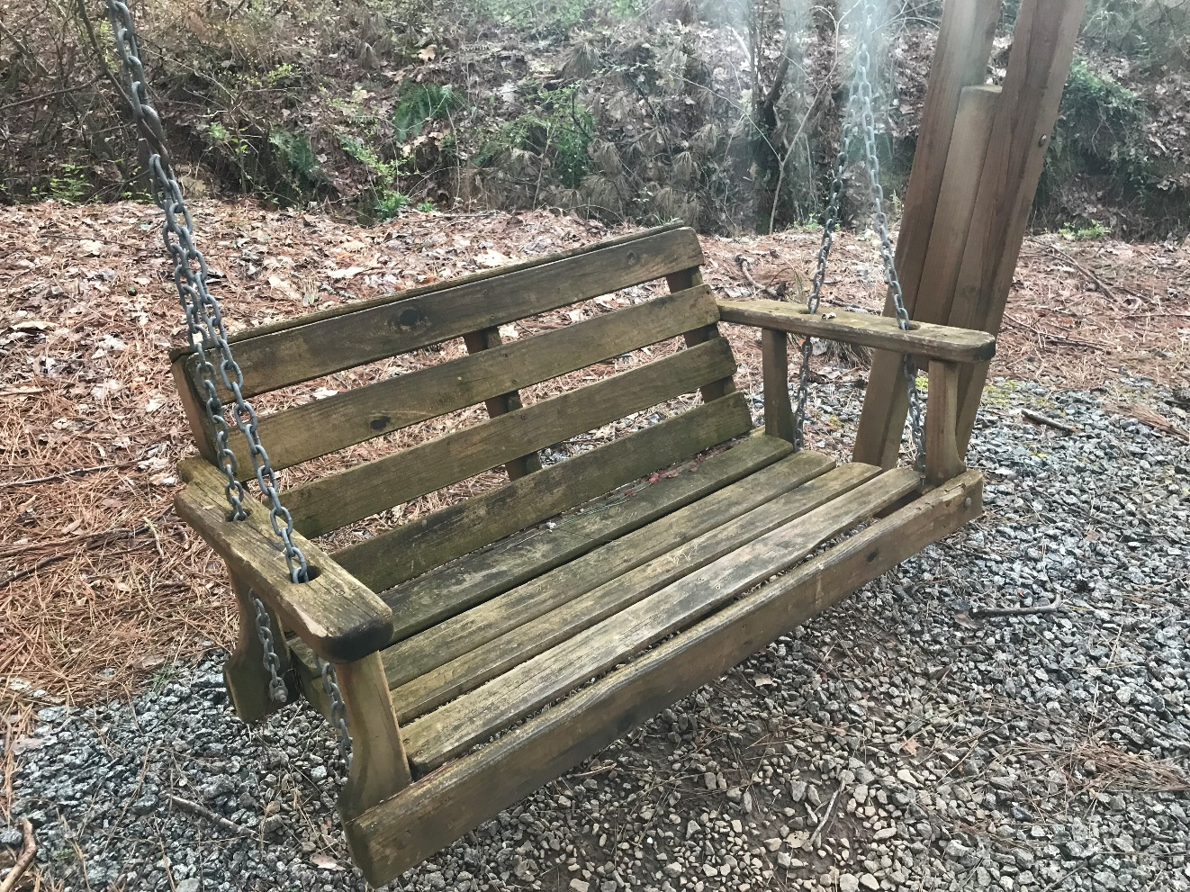
Swing along walk path – Old boards need to be replaced, powerwashed and treated

Slide 12
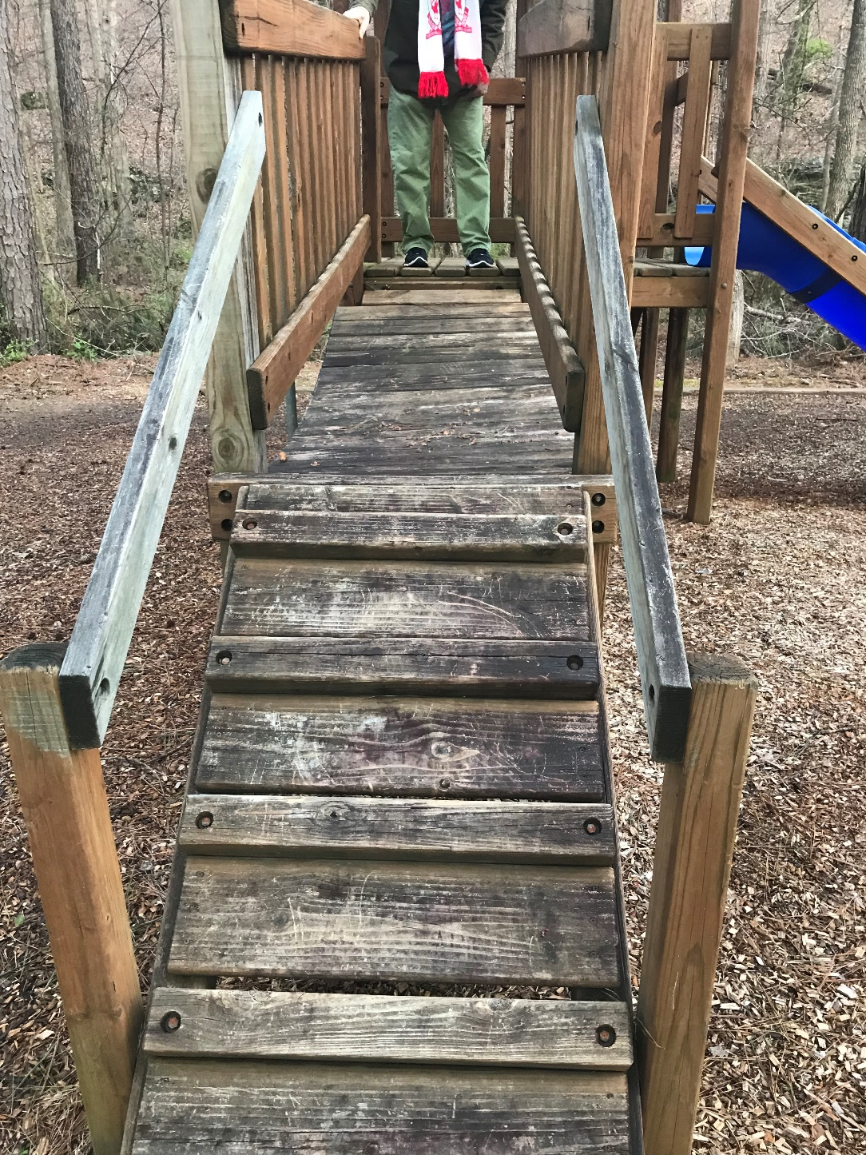
Kids play area – Needs to be powerwashed and treated. Any old rotten boards need to be replaced.

Slide 13
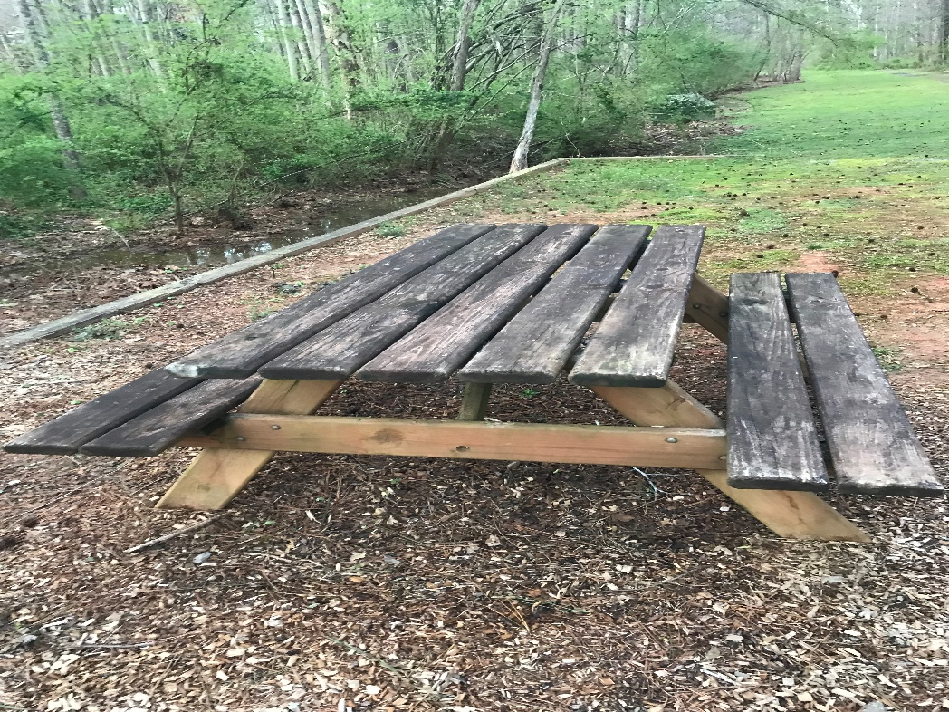
Picnic Bench – Needs to be powerwashed and treated. Any old rotten boards need to be replaced.

Slide 14
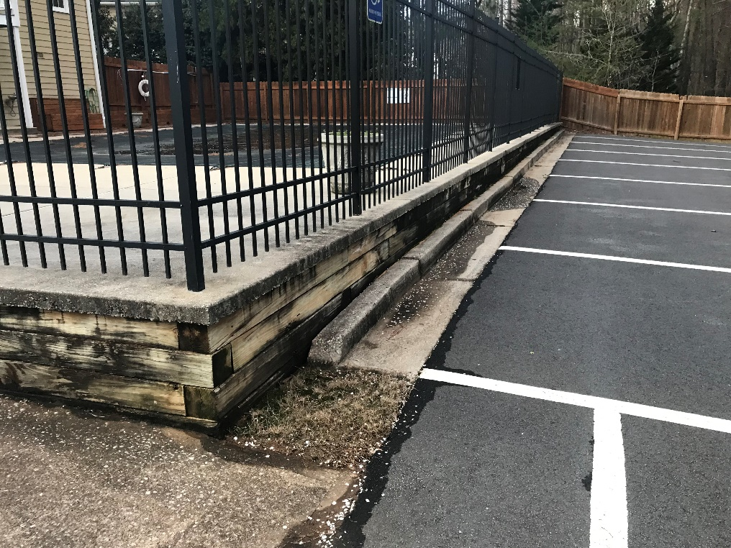
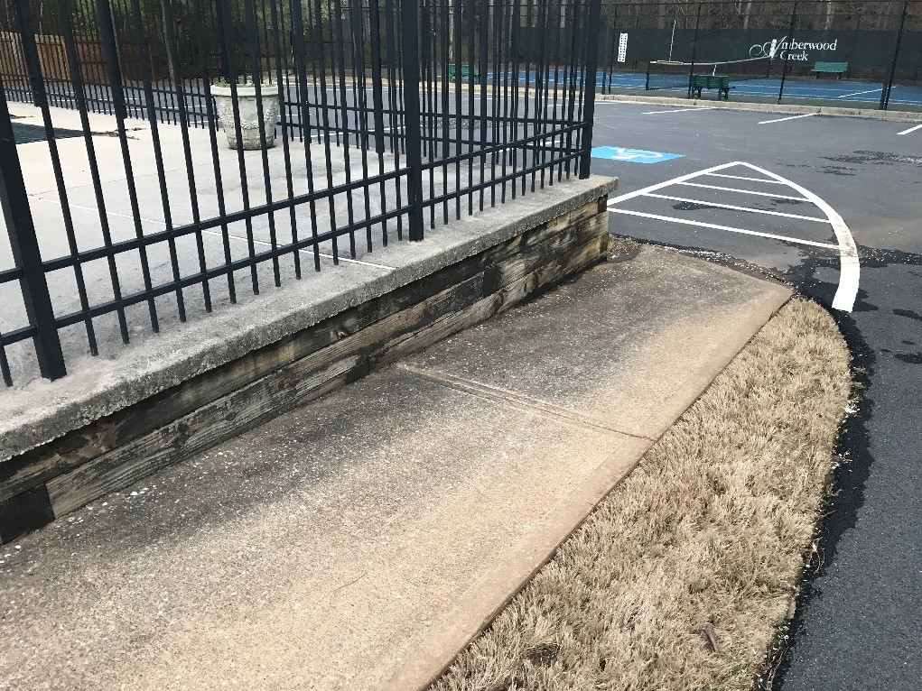
Wall along Pool – Needs to be powerwashed and treated.

Slide 15
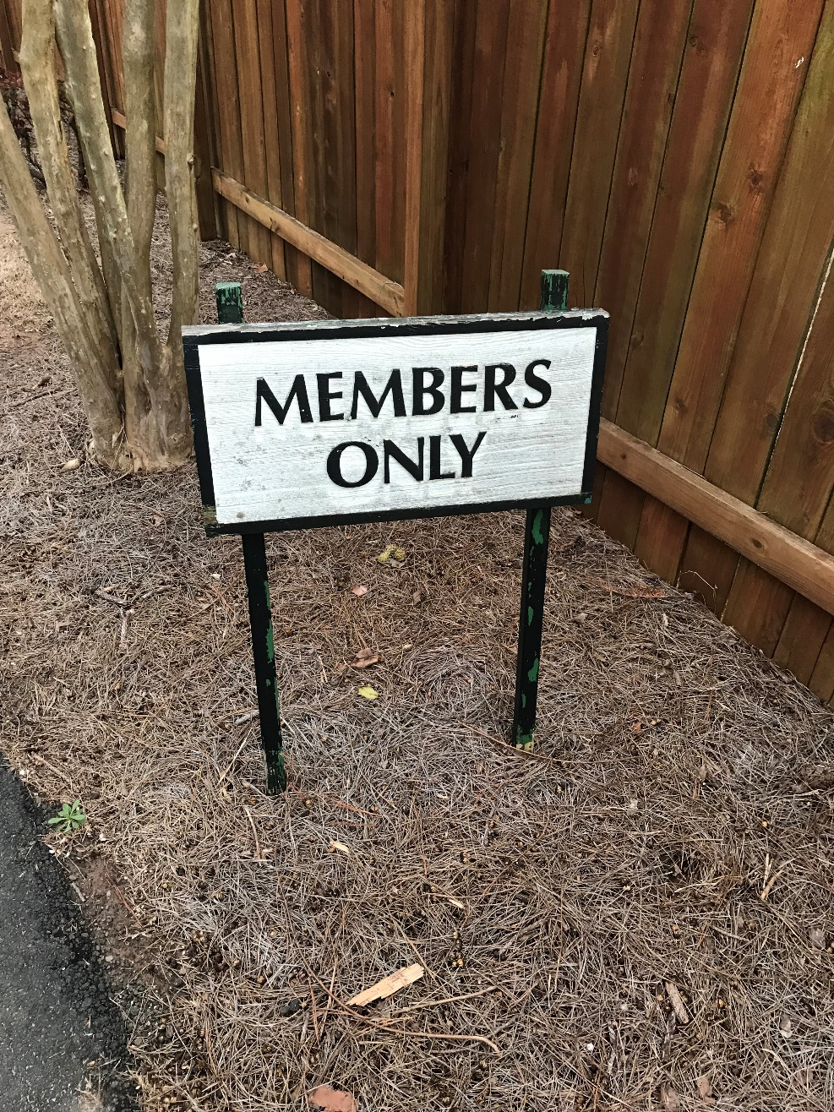
Members Only sign at Clubhouse – Sign needs to be painted

